Slide 1
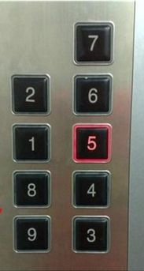
Fundamentals of Interaction Design
CSCI 5839 Fall 2014
Notes:
http://media-cache-ec0.pinimg.com/236x/c2/a5/86/c2a58664f589a2447dcb6ca6111e5226.jpg

Slide 2
Hi!
How was class on Tuesday? :)
Sorry for confusion about assignments! :( any questions?
Where I was: 2014 ACM conference on computers and Accessibility (ASSETS 2014)

Slide 3
ASSETS papers
http://dl.acm.org/citation.cfm?id=2661334&picked=prox&CFID=433221996&CFTOKEN=14371626
Cool papers on
Haptic steering wheels for blind drivers
Google Glass to guide blind users
3D printing in special education classrooms
Interactive gestures for power wheelchairs

Slide 4
High level view of class
First: understanding users
Second: designing, sketching, expressing ideas
Now: best practices for user interface design; evaluation techniques

Slide 5

Today
(Some) principles of interaction design
Norman: how to apply principles of psychology to design?
Design of Everyday Things (1988); formerly Psychology of Everyday Things
Notes:
http://en.wikipedia.org/wiki/The_Design_of_Everyday_Things#mediaviewer/File:The_Design_of_Everyday_Things_(cover_1988).jpg

Slide 6
Interaction design?

Slide 7
Interaction design?
Interaction design focuses on creating engaging interfaces with well thought out behaviors. Understanding how users and technology communicate with each other is fundamental to this field. With this understanding, you can anticipate how someone might interact with the system, fix problems early, as well as invent new ways of doing things.
http://www.usability.gov/what-and-why/interaction-design.html

Slide 8
Norman
Comments on Piazza seemed positive
What was unclear?
What is out of date? (published in 1988)
Good, common-sense writing, but some deep and useful tools here

Slide 9
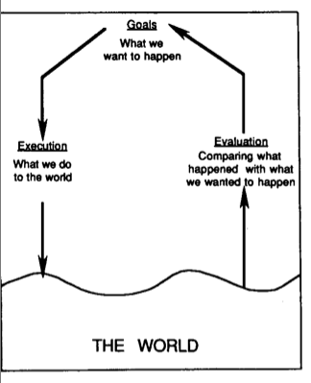
The Action Cycle

Slide 10
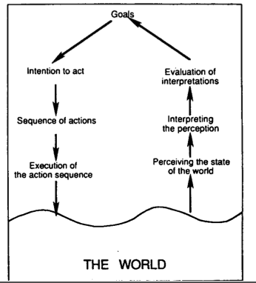
Gulfs of execution/evaluation

Slide 11
Gulfs of execution/evaluation
Gulf of execution
“How do I do it?”
How to fix: rules, affordances, constraints (so I can’t do the wrong thing), instructions
Gulf of evaluation
“It doesn’t work”
“Was I successful?”
How to fix: Feedback

Slide 12
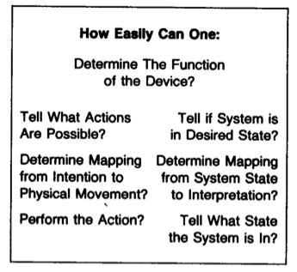
How these map to design
Visibility
Good conceptual model
Good mappings
Feedback

Slide 13
Important ideas from Norman
It’s not the user’s fault
Affordances (vs. conventions)
Conceptual models
Make things visible (system status)
Feedback
Mapping
Constraints

Slide 14
Let’s play a game
Groups of two (Come up with a cool team name)
Let’s take 10 minutes to find examples of Norman’s concepts in this classroom
Indicate whether they are successful
Team with the most (reasonable) examples will get some extra credit
Will hand them in on a single sheet of paper

Slide 15
Norman scavenger list
Affordances
Design conventions
Mappings
Natural mappings
Visible system status
Feedback
Constraints

Slide 16
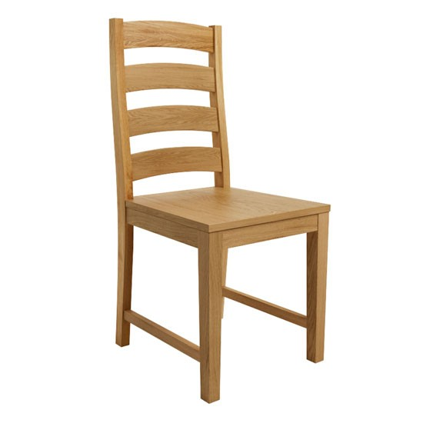

Affordances
How environment structures interaction
(cf JJ Gibson, environmental psychology)

Slide 17
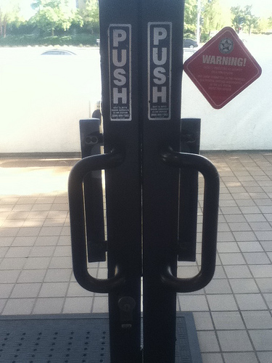
Why affordances are cool
Don’t need instructions!
Or can provide minimal instructions

Slide 18
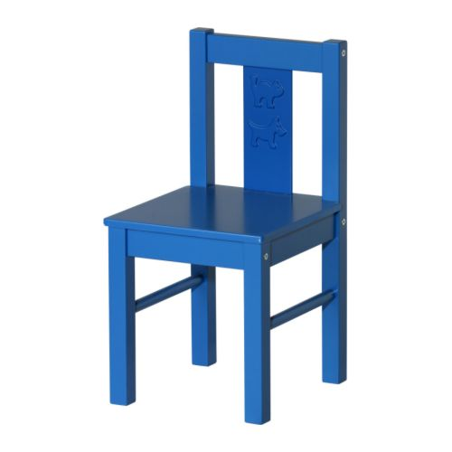
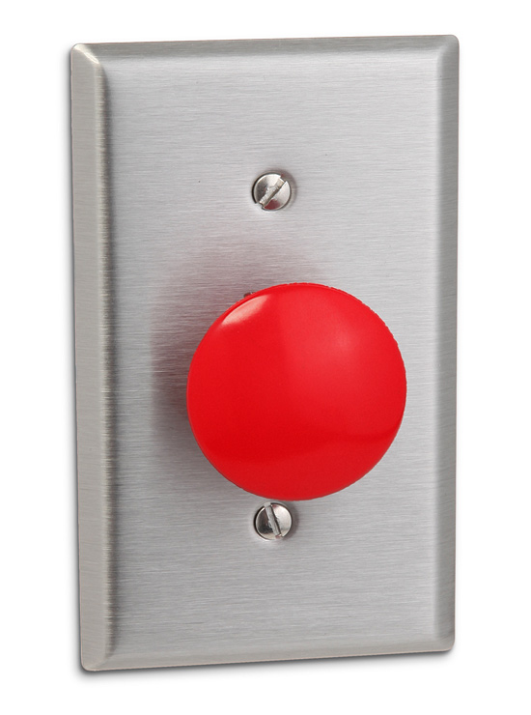
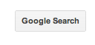
Perceived vs. actual affordance
Affords sitting
Affords pushing
Perceived affordance

Slide 19
Affordances vs. convention
What does this do?

Slide 20
Affordances vs. convention
What does this do?
A cultural convention: blue underlined things are web links

Slide 21
Conceptual models
How the system works vs. how the user thinks it works

Slide 22
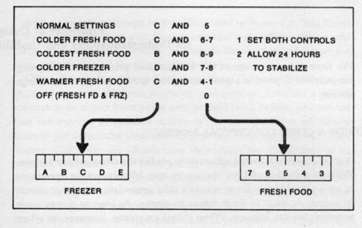
Conceptual models
Breakdown when user’s conceptual model works differently than the actual system (the system model)

Slide 23
System status and feedback
What’s going on?
What did I just do?

Slide 24
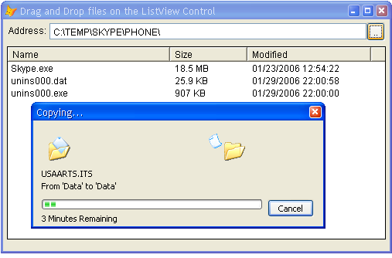
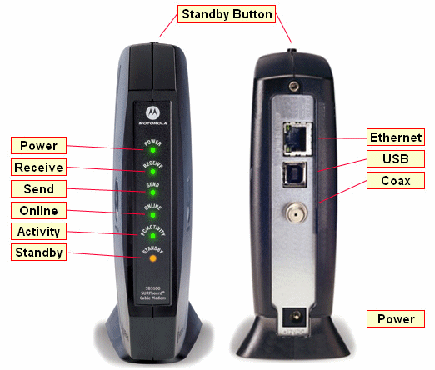
System status

Slide 25
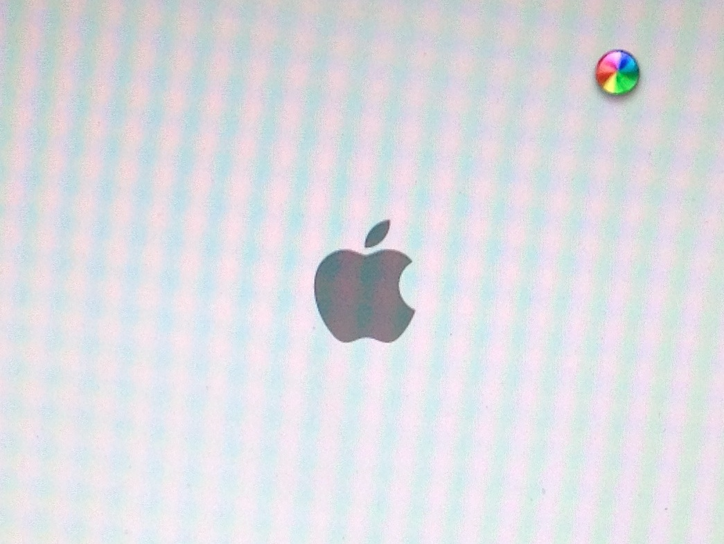
System status
Good?
Bad?

Slide 26
System status
Good?
- Tells me I need to wait
Bad?
Why?
How long?
What is it doing?

Slide 27
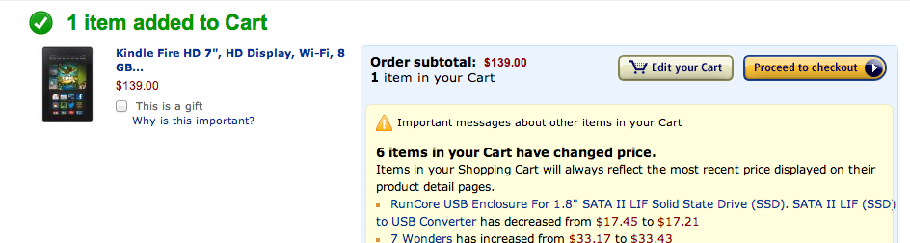
Feedback

Slide 28
Mapping
Relation between controls and the things that they control
What is a good mapping?

Slide 29
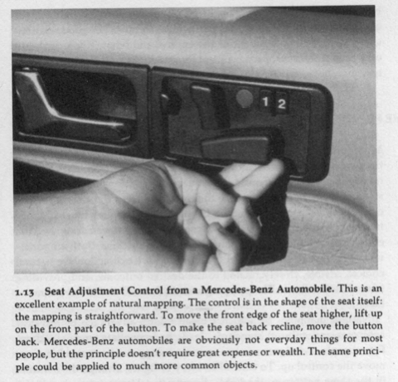
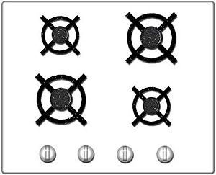
Mapping

Slide 30
Mapping
Arbitrary mapping
Natural mapping
Notes:
How do we fix arbitrary mapping?

Slide 31
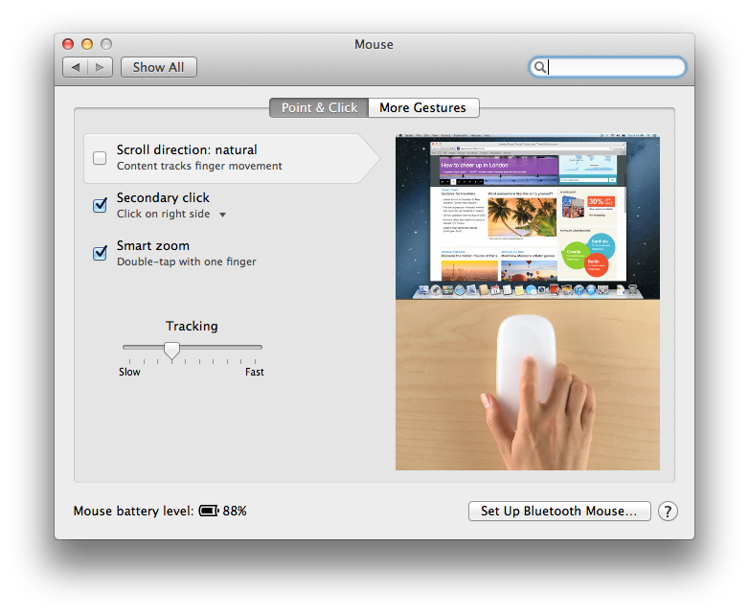

Slide 32
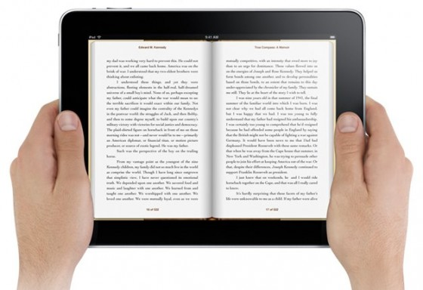

Slide 33
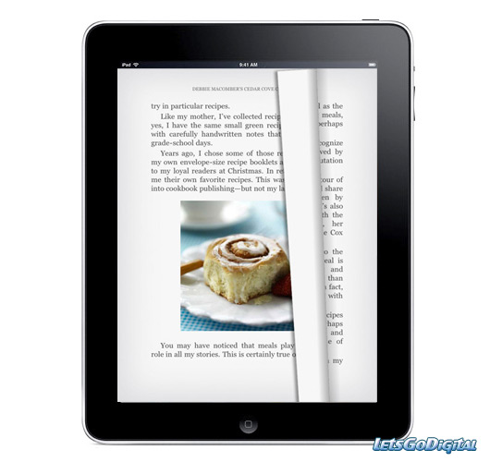

Slide 34
Constraints
What are they?
Good/bad?

Slide 35
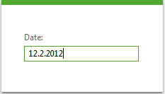
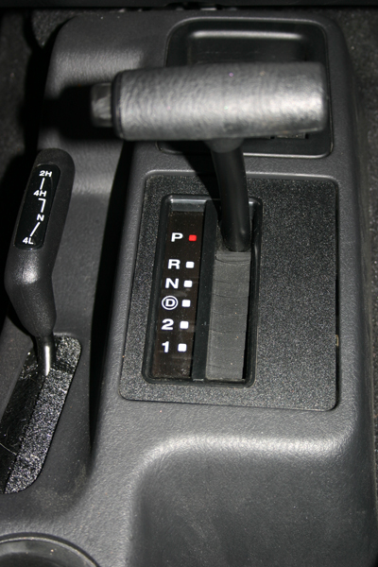
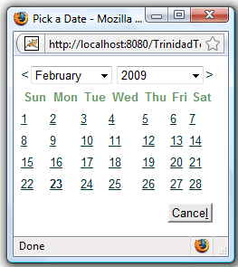
Constraints
Notes:
Drawback of date field?

Slide 36
Emotional Design (Norman, 2004)
Three levels of design
Visceral – raw emotional/physical experience
Behavioral – does it work the way I expect?
Reflective – how does using this affect my perception of myself, life, the universe, everything?

Slide 37
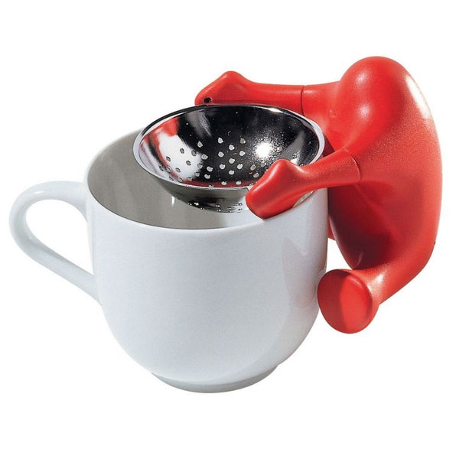
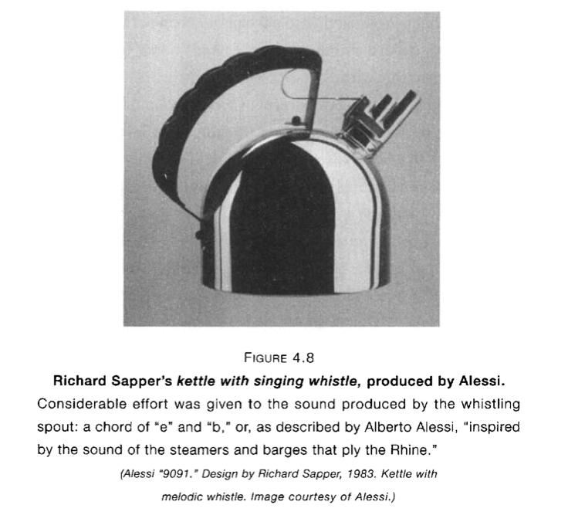
Playfulness and fun
Alessi tea strainer

Slide 38
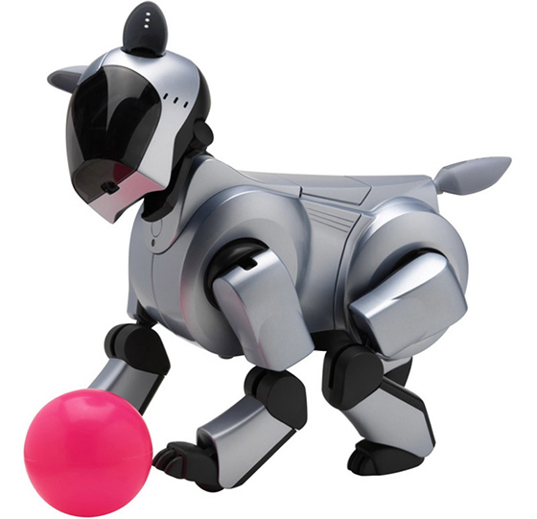
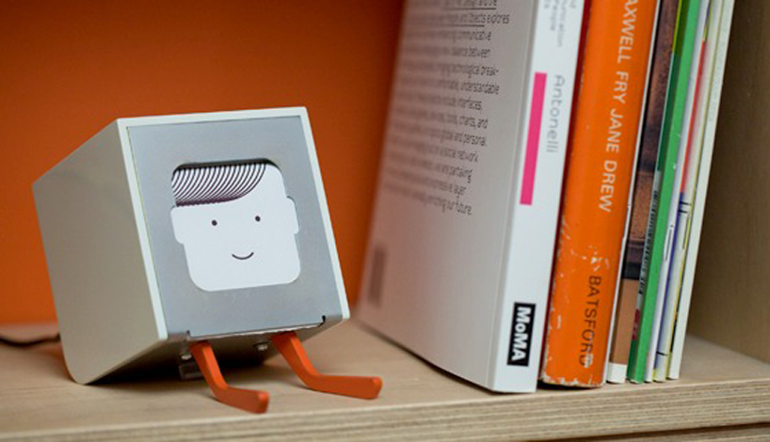
Technology with personality
BJ Fogg, “computers as social actors”
Physical: Face, eyes, body, movement
Psychological: Preferences, humor, personality, feelings, empathy, "I'm sorry"
Language: Interactive language use, spoken language, lan- guage recognition
Social Dynamics: Turn taking, cooperation, praise for good work, answering questions, reciprocity
Social Roles: Doctor, teammate, opponent, teacher, pet, guide

Slide 39
Other aspects of design
Ergonomics / human factors
Accessibility / universal design

Slide 40
What else do we need to know?

Slide 41
What else do we need to know?
Guidelines/heuristics on good design
Next week (usability heuristics and heuristic evaluation)
Standards
“When should buttons be on the top or the bottom of the screen?”
Example: Apple Human Interface Guidelines
User interface controls/toolkits
Example: Twitter Bootstrap, iOS controls

Slide 42
Activity
What aspects of your project involve interaction design?

Slide 43
Next time
Heuristics for good design
Evaluating with heuristics

